Slide 1






Tag Helpers
Tag Helpers in ASP.NET Core are the server-side components. They are basically used to perform defined transformations on HTML Elements.
Tag Helper
As they are server-side components, so they are going to be processed on the server to create and render HTML elements in the Razor files.
The Tag Helpers are similar to the HTML helpers in ASP.NET Framework, but are new feature in ASP.NET Core.
The Tag helpers used in Razor Pages were introduced as part of ASP.NET MVC Core and are found in the Microsoft.AspNetCore.Mvc.TagHelpers package which is included as part of the Microsoft.AspNetCore. All meta-package.
Tag helpers are reusable components for automating the generation of HTML in Razor Pages. Tag helpers target specific HTML tags.

Slide 2
What happened to HTML Helpers
HTML helpers were methods accessed through Razor expressions that begin with @Html
Example ➔ @Html.TextBoxFor(m => m.Name) ➔ would create a textbox for the name property.
The problem with HTML helper expressions is that they don’t fit with the structure of HTML elements, which leads to awkward expressions, especially when adding CSS,
Example ➔ @Html.TextBoxFor(m => m.Name, new { @class = “form-control” }). ➔
Attributes have to be expressed in a dynamic object and have to be prefixed with @ if they are reserved C# words, like class.
As the HTML elements that are required become more complex, the HTML helper expression becomes more awkward.
Tag helpers remove this awkwardness,
Example ➔ <input class=”form-control” asp-for=”Population” />
The result is a more natural fit with the nature of HTML and produces views that are easier to read and understand. MVC still supports HTML helpers, so you can use them for backward compatibility in views originally developed for MVC 5, but new views should take advantage of the more natural approach that tag helpers provide.
To a front-end designer (someone familiar with HTML/CSS/JavaScript and other client technologies but not familiar with C# and Razor), most of the line is foreign.

Slide 3
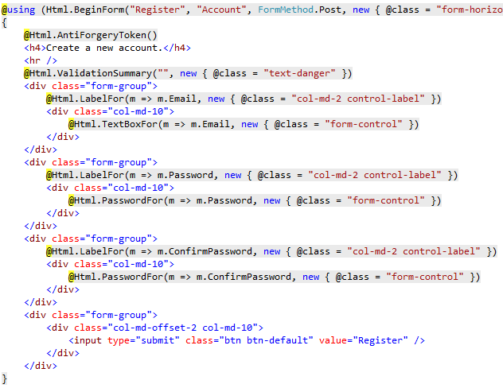
Tag Helpers compared to HTML Helpers
The following code image shows the Form portion of the Views/Account/Register.cshtml Razor view generated from the ASP.NET 4.5.x MVC template included with Visual Studio.
The Visual Studio editor displays C# code with a grey background. Most of the markup in the Register view is C#.
Compare that to the equivalent approach using Tag Helpers:

Slide 4
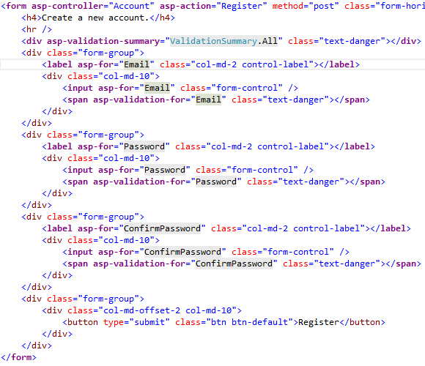
Tag Helpers compared to HTML Helpers contd.
The markup is much cleaner and easier to read, edit, and maintain than the HTML Helpers approach. The C# code is reduced to the minimum that the server needs to know about.
Each of the "asp-" attributes has a value of "Email", but "Email" isn't a string. In this context, "Email" is the C# model expression property for the RegisterViewModel

Slide 5



Types of Tag Helpers
There are two types of Tag helpers in ASP.NET Core. They are as follows .
Built-In Tag Helpers: They come in-built in the ASP.NET Core Framework and can perform common tasks like generating links, creating forms, loading assets, showing validation messages, etc.
Built-In Tag Helpers
Custom Tag Helpers
Custom Tag Helper: That can be created by us to perform our desired transformation on an HTML element.
How to use built-in Tag Helpers
You need to import Tag Helpers using the @addTagHelper directive in _ViewImports.cshtml file as shown below.
@addTagHelper *, Microsoft.AspNetCore.Mvc.TagHelpers
The @addTagHelper makes the built-in tag helpers to available in the application which are defined in an assembly called Microsoft.AspNetCore.Mvc.TagHelpers. Here the wildcard “ * “ specifies that all the Tag Helpers are made available

Slide 6
Types of Tag Helpers
There are two types of Tag helpers in ASP.NET Core. They are as follows .
Built-In Tag Helpers: They come in-built in the ASP.NET Core Framework and can perform common tasks like generating links, creating forms, loading assets, showing validation messages, etc.
Built-In Tag Helpers
Custom Tag Helpers
Custom Tag Helper: That can be created by us to perform our desired transformation on an HTML element.
Built-In Tag Helpers:
Anchor tag helper
Form tag helper
Image tag helper
Input tag helper
Label tag helper
Select tag helper
TextArea tag helper
Option tag helper
Cache tag helper
Environment tag helper
Partial tag helper
Link tag helper
Script tag helper
Validation tag helper
Validation Summary tag helper

Slide 7
Understanding the Anchor Tag Helper
:
The Anchor Tag Helper in ASP.NET Core creates the standard HTML anchor (<a … ></a>) tag by adding new attributes such as:
asp-controller: It is used to specify the controller to target based on the routing system. If you omitted this, then the controller of the current view is used by default.
asp-action: It is used to specify the Action method to target based on the routing system. If you omitted this attribute then the action rendering the current view is used by default.
asp-route-{value}: It is used for specifying the additional segment value for the URL. For example, asp-route-id is used to provide value for the ‘id’ segment.
The rendered anchor element’s “href” attribute value is determined by the values of these “asp-“ attributes.
As the name says, asp-controller specifies the name of the controller whereas asp-action specifies the name of the action name.
Similarly, the asp-route-{value} attribute is used to include route data in the generated href attribute value. {value} can be replaced with route parameters such as id, name, etc.
<a class="nav-link" asp-controller=“Home" asp-action="index">Home</a>

Slide 8
Understanding the Form Tag Helpers
In order to create a Form in ASP.NET Core Application, we need to use the following common Tag Helpers.
Form Tag Helper
Input Tag Helper
Label Tag Helper
Textarea Tag Helper
Radio Button Tag Helper
Select Tag Helper
<form asp-controller="Demo" asp-action="Register" method="post">
<!-- Input and Submit elements -->
</form>

Slide 9
Understanding the Form Tag Helpers
Input Tag Helper | <input asp-for=”Name”> The above input tag helper generates an input element with id and name attributes. And both the id and name are set to a value as Name as shown below. <input type=”text” id=”Name” name=”Name” value=“”>
<label asp-for=”Name”></label>

